Slide 1

BELLA:
“YOUR PERSONAL WELLNESS ASSISTANT AT WORK"

Slide 2

Benta Irungu
Carolyne Kambura
Harriet Joseph
Kepha Atika
Kennedy Murithi
TEAM BELLA

Slide 3
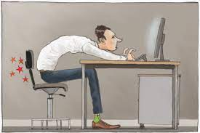
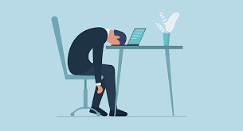

Overview:
Desk-Bound Worker Statistics:
Studies show approximately 16% of Global workers have desk-bound jobs, spending an average of 6-8 hours sitting at their desks each day.
Prolonged sitting is associated with various health issues, including obesity, musculoskeletal problems, and increased risk of chronic diseases.
Source:
1. https://www.health.harvard.edu/pain/the-dangers-of-sitting
2. Daneshmandi H, Choobineh A, Ghaem H, Karimi M. Adverse Effects of Prolonged Sitting Behavior on the General Health of Office
Workers. J Lifestyle Med. 2017 Jul;7(2):69-75. doi: 10.15280/jlm.2017.7.2.69. Epub 2017 Jul 31. PMID: 29026727; PMCID: PMC5618737.

Slide 4
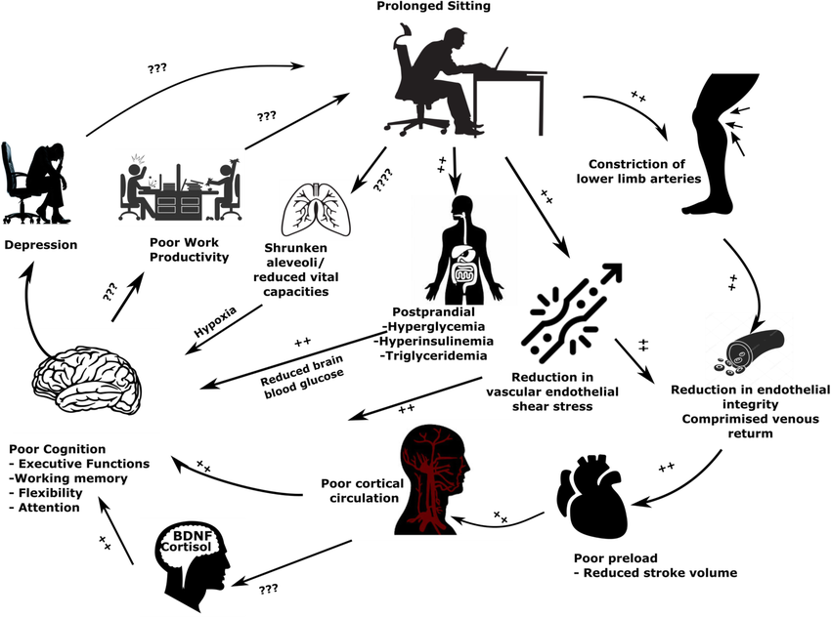
PROBLEM STATEMENT
Desk-bound workers face various challenges in maintaining a healthy lifestyle, including:
Prolonged sitting leading to health risks such as obesity, cardiovascular issues, and musculoskeletal problems.
High stress levels and reduced mental focus due to continuous work without breaks.
Lack of awareness about ergonomic practices, resulting in discomfort and work-related injuries.

Slide 5
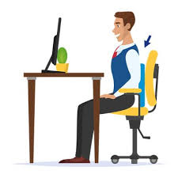

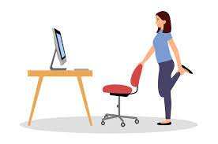
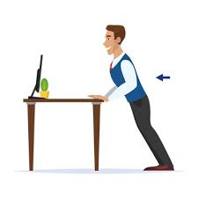
OBJECTIVE:
Create an AI conversational assistant that provides
personalized and interactive support to users in their fitness
and wellness journeys.

Slide 6
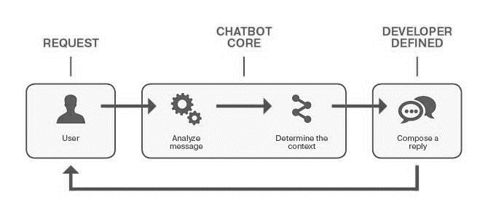
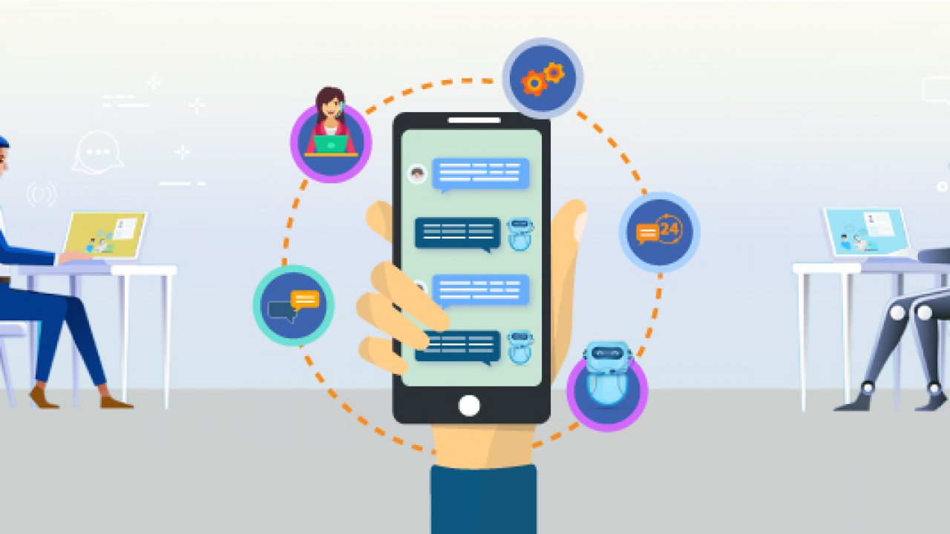
CHATBOT ARCHITECTURE
USER INPUT
EX:
Shoulder Exercises?

Slide 7

FEATURES AND CAPABILITIES
Workouts
Exercises and Stretch routines
Ergonomics
Proper posture and Desk Set-up
Diet
Personalized diet recommendations
Send Break Reminders
Guide
Physical and Mental Mindfulness
Tailored
Personalized Wellness recommendations
Track Progress
Reminders
Stress Management
Emotional support
Tracking

Slide 8

DEPLOYMENT
Hello! I'm Bella, your personal fitness and wellness assistant. How can I help you today?

Slide 9
CONCLUSION
Bella is a remarkable wellness chatbot that offers invaluable assistance to individuals seeking to enhance their overall well-being.
Its advanced natural language processing capabilities make interactions feel like conversing with a human expert, making the experience personalized and engaging.
However, it is crucial to recognize that Bella is not a substitute for any wellness professional care but serves as a supportive tool, providing users with relevant information, motivation, and guidance on their wellness journey.
By combining technology and human touch, Bella empowers users to take charge of their health while understanding the importance of seeking professional medical advice for specific conditions, such as diabetes management.

Slide 10
RECOMMENDATIONs
Launch Bella as a wellness chatbot, targeting desk-bound workers in various industries.
Integration with wearable devices and smartwatches offers opportunities for real-time health tracking and personalized recommendations.
Collaborations with corporate wellness programs present avenues for reaching a larger audience and promoting workplace wellness initiatives.
Gather user feedback for continuous improvement and consider integrating with productivity tools to enhance functionality.
Offer chatbot in multiple languages

Slide 11

Any Questions/Comments?
Thank You!
Remember to stay active and take care ☺.

